Slide 1

The Nature of IT Project
Chapter 1
SDEV 3303 - Software Projects Management

Slide 2
Learning Objectives
Understand why information technology (IT) projects are organizational investments.
Define what a project is and describe the attributes of a project.
Define the discipline called project management.
Understand the relationship among project portfolios, programs, and projects.
Understand how the disciplines of information technology and project management have evolved.
Understand the current state of IT project management.
Understand why some projects fail and how to improve the likelihood of success.

Slide 3
Introduction
Information Technology (IT) projects are organizational investments that require:
Time
Money
And other resources such as people, technology, facilities, etc.
Organizations expect some type of value in return for this investment.
IT projects enable the integration of technology in new products, services, or processes that can change existing relationships between an organization and its customers and suppliers as well as among the people within the organization.

Slide 4
Introduction
IT projects are not just about technology. Today, we must take a technical approach, as well as a project management and knowledge
management approach so
that we understand how people, must work together within the
technology, and processes organization.
In addition, IT projects tend to be very political because they can change the balances of power within the organization and change relationships among people within the organization.

Slide 5
Introduction
IT Project
Technical approach,
project management, knowledge management approach
People
Technology
Processes

Slide 6
Introduction
As a project manager or project team member, you must understand the organizational environment.
IT projects are planned organizational change; therefore, when you take on an IT project you are consciously planning on changing the organization.

Slide 7




Introduction
Value
Time

Slide 8
Project Management Institute
The Project Management Institute (PMI) is an organization that was founded in 1969.
Global nonprofit professional association in the area of project management.
PMI establishes many project management standards and provides seminars, educational programs, and professional certifications that are recognized globally.
It also maintains the Guide to the Project Management Body of Knowledge (PMBOK© Guide).

Slide 9
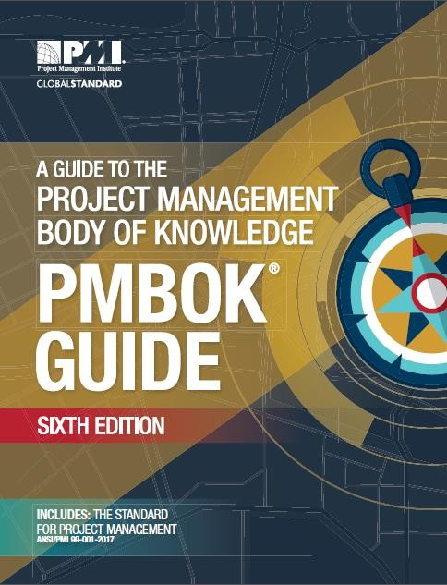
PMBOK© Guide
A document available from the Project Management Institute (PMI®).
It includes proven traditional practices that are widely applied as well as innovative practices that are emerging in the profession.

Slide 10

What is a project?
A project is a temporary endeavor undertaken to create a unique product, service, or result.
Start
End
Unique: different design, different settings, … etc.
A project manager is the person assigned by the performing organization to achieve the project objectives.

Slide 11
Project Attributes
Time Frame
Purpose (to provide value!)
Ownership
Resources (the triple constraint)
Roles
Project Manager
Project Sponsor
Subject Matter Expert (SME)
Technical Expert (TE)
Risk & Assumptions
Interdependent Tasks
progressive elaboration – steps & increments
Planned Organizational Change
Operate in Environments Larger than the Project Itself

Slide 12
What is Project Management?
Project Management - is the application of knowledge, skills, tools
and techniques to project activities to meet project requirements.
Project Portfolio - a collection of diverse projects managed collectively to align with the organization’s strategy and overall plan to achieve competitive advantage.
Program – a collection of projects within a project portfolio whose activities are coordinated so that the benefits of the program are great than the sum of the benefits of the individual projects.

Slide 13
What is Project Management?
Organizational Strategy
Portfolio
Program A
Program B
Project 1
Project 2
Project 3
Project 4
Project 6
Operation

Slide 14
Projects vs. Operations
Projects
Operations
Temporary & Unique
Product, Service, Result
E.g. development of mobile app
Ongoing & Repetitive
Transform inputs into outputs
E.g. production of good & services

Slide 15
Project Management & IT
1940s | 1950s | 1960s | 1970s | 1980s | 1990s | 2000s | 2010s
First Electronic Computer
EDP
Era
PC
Era
Network
Era
Globalization

Slide 16
The State of IT Project Management
The Standish Group (CHAOS studies) and others have studied IT project success and failure.
In general, a successful project is defined as one that is completed on
time, within budget, and including all of the features or
requirements envisioned.
The bottom line is that, on a percentage basis, failed or challenged projects greatly exceed successful projects.

Slide 17
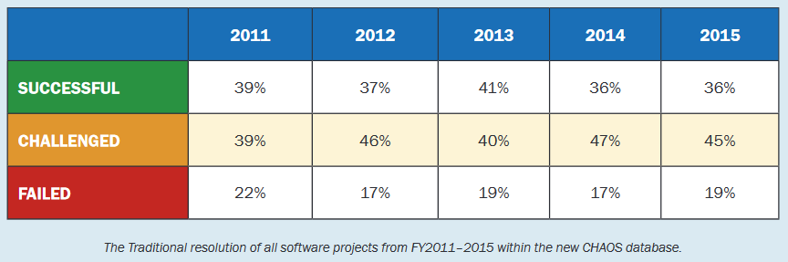
The State of IT Project Management

Slide 18
Why Many Projects Fail?
People – The stakeholders of a project with varied roles and interests in the project’s success or failure.
Processes – This includes having a set of project management and product management processes.
Technology – Only three percent of IT project failures can be attributed to
technical challenges but this percentage can be increased if obsolete, unproven, or incompatible technologies are used.
Organization – Organizational issues can lead to project failure. A lack of
clear direction, improper strategy, rapidly changing business environment
and/or customer needs can create a moving target for the product’s product or service.

Slide 19
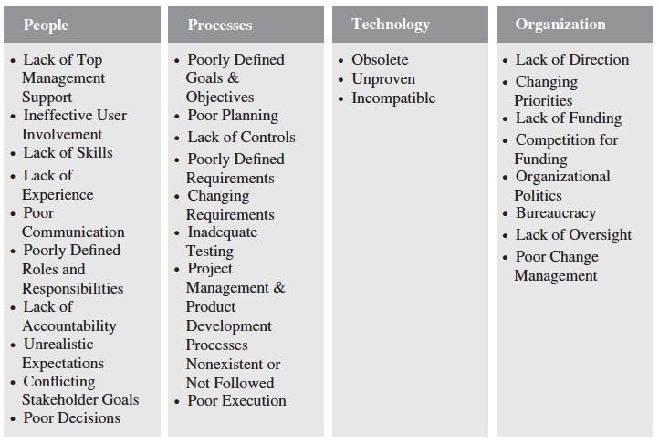
Why Many Projects Fail?

Slide 20
Improving the likelihood of success
A Value-Driven Approach
Plain & Simple: IT Projects must provide value to the organization
Socio-technical Approach
It’s not just about the technology or building a better mouse trap
Project Management Approach
processes and infrastructure (Methodology)
resources
expectations
competition
efficiency and effectiveness
Knowledge Management Approach
lessons learned, best practices & shared knowledge

Slide 21
A Value-Driven Approach
The decision to fund or invest in an IT project should be based on the value that the completed project will provide the organization.

Slide 22
Thank You

